Slide 1
Deep CNNs
Matthew Engelhard
Many slides created by Tim Dunn

Slide 2
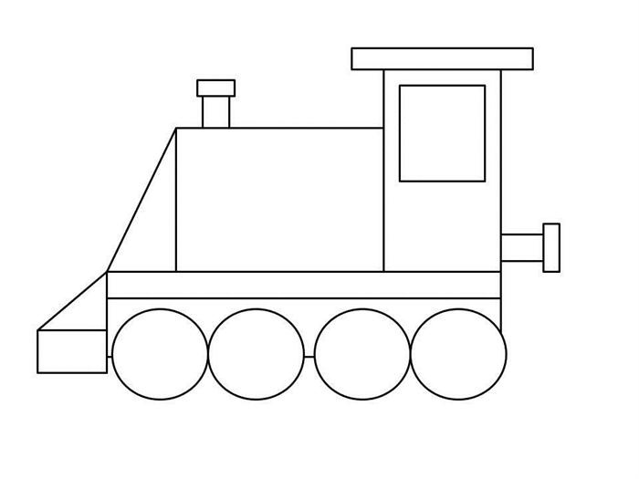
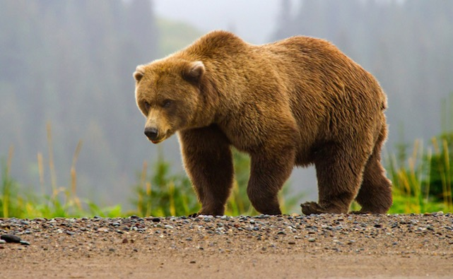
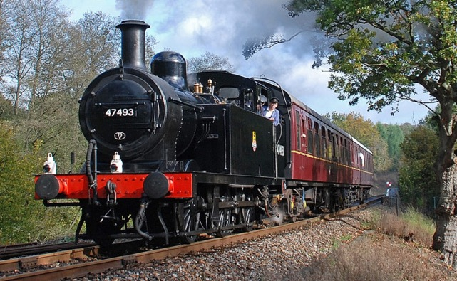
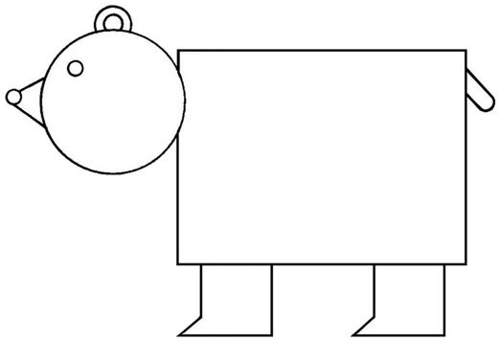
CNNs Take Advantage of Repeated, Hierarchical Structure in Images
Notes:
Show real bear & train

Slide 3
CNNs Take Advantage of Repeated, Hierarchical Structure in Images
Low-level structure: lines, curves
Notes:
Show real bear & train

Slide 4
CNNs Take Advantage of Repeated, Hierarchical Structure in Images
Mid-level structure: shapes

Slide 5
CNNs Take Advantage of Repeated, Hierarchical Structure in Images
High-level structure: groups of shapes
Notes:
Add bounding boxes here

Slide 6
CNNs Take Advantage of Repeated, Hierarchical Structure in Images
Bear
Train
High-level structure: groups of shapes → objects
Notes:
Point out similarities in groups of shapes

Slide 7
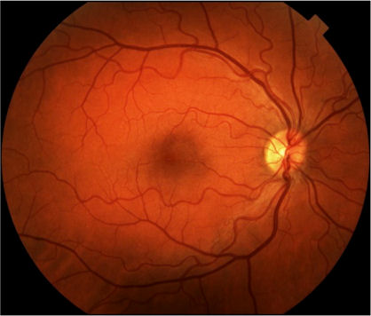
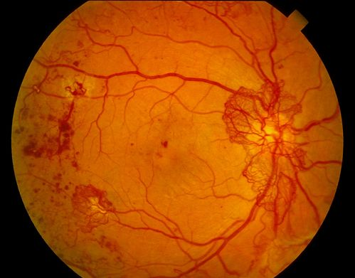

Deep Learning for Image Analysis
Diabetic Retinopathy Classification
Healthy Retina
Unhealthy Retina
Notes:
Low: Lines, curves
Mid: blood vessels, exudates, spots, aneurysms
High: specific pathologies
Very high: refer or not

Slide 8

Consider a Set of “Toy” Images,
for illustration of how this structure can be extracted by an algorithm
Notes:
Constructed motifs.
Where the motifs at different levels are deliberate and clear.
This will allow us to think about filters that identify motifs at different levels, and how filters at different levels work together.

Slide 9
High-Level Motifs/Structure
Notes:
Note that these motifs can occur in different parts of the images

Slide 10
Shared Substructure Within Motifs
Notes:
Color code individual elements rather than having boxes. Cut down on the number of submotifs

Slide 11
Shared Substructure Within Motifs

Slide 12
Shared Substructure Within Motifs

Slide 13
Shared Substructure Within Motifs

Slide 14
Hierarchical Representation of Images
Layer 3:
Motifs
Layer 2:
Sub-Motifs
Layer 1:
Fundamental Building Blocks
Notes:
Spend time here explaining that we’ve established 3 levels. That if we had a system that could extract features of each level in sequence, we could build up a hierarchical feature map.

Slide 15
Recall the Data/Images
Notes:
Remove noise?

Slide 16
Convolutional Filter
Notes:
Add the image as a watermark, and make the heatmap light up w/o circles – add grid and have it light up.
Really belabor point that this creates feature heatmaps

Slide 17
Convolutional Filter
Notes:
Add the image as a watermark, and make the heatmap light up w/o circles – add grid and have it light up.
Really belabor point that this creates feature heatmaps

Slide 18
Convolutional Filter
Notes:
We’ll call these outputs “feature maps”, because they tell us about the locations of a specific feature.

Slide 19
Multiple Filters, One for Each Building Block
Input Image
Filters

Slide 20
Feature “Maps”
Input Image
Filters

Slide 21
Feature “Maps”
Layer-2 Filters
Input Image
Filters
Notes:
Color code the filters in this slide already

Slide 22
Feature “Maps”
Layer-2 Filters
Input Image
Filters

Slide 23
Layer 1
Feature “Maps”
Layer-2 Filters
Input Image
Layer-1 Filters

Slide 24
Layer 2
Feature “Maps”
Layer 1
Feature “Maps”
Layer-2 Filters
Input Image
Layer-1 Filters

Slide 25
Layer 2
Feature “Maps”
Layer-3 Filters
Layer 1
Feature “Maps”
Layer-2 Filters
Input Image
Layer-1 Filters

Slide 26
Layer 3
Feature “Maps”
Layer 2
Feature “Maps”
Layer-3 Filters
Layer 1
Feature “Maps”
Layer-2 Filters
Input Image
Layer-1 Filters

Slide 27
Deep CNN Architecture
Layer 3
Feature “Maps”
Classifier
Layer 2
Feature “Maps”
Layer-3 Filters
Layer 1
Feature “Maps”
Layer-2 Filters
Input Image
Layer-1 Filters
Notes:
High-level layer-3 feature maps: look for presence of hemorrhagic spots.

Slide 28
Advantage of Hierarchical Features?
By learning and sharing statistical similarities
within high-level motifs, we better leverage
all training data
If we do not use such a hierarchy, top-level
motifs would be learned in isolation of
each other
Layer 3:
Layer 2:
Layer 1
Notes:
Need to change words here

Slide 29
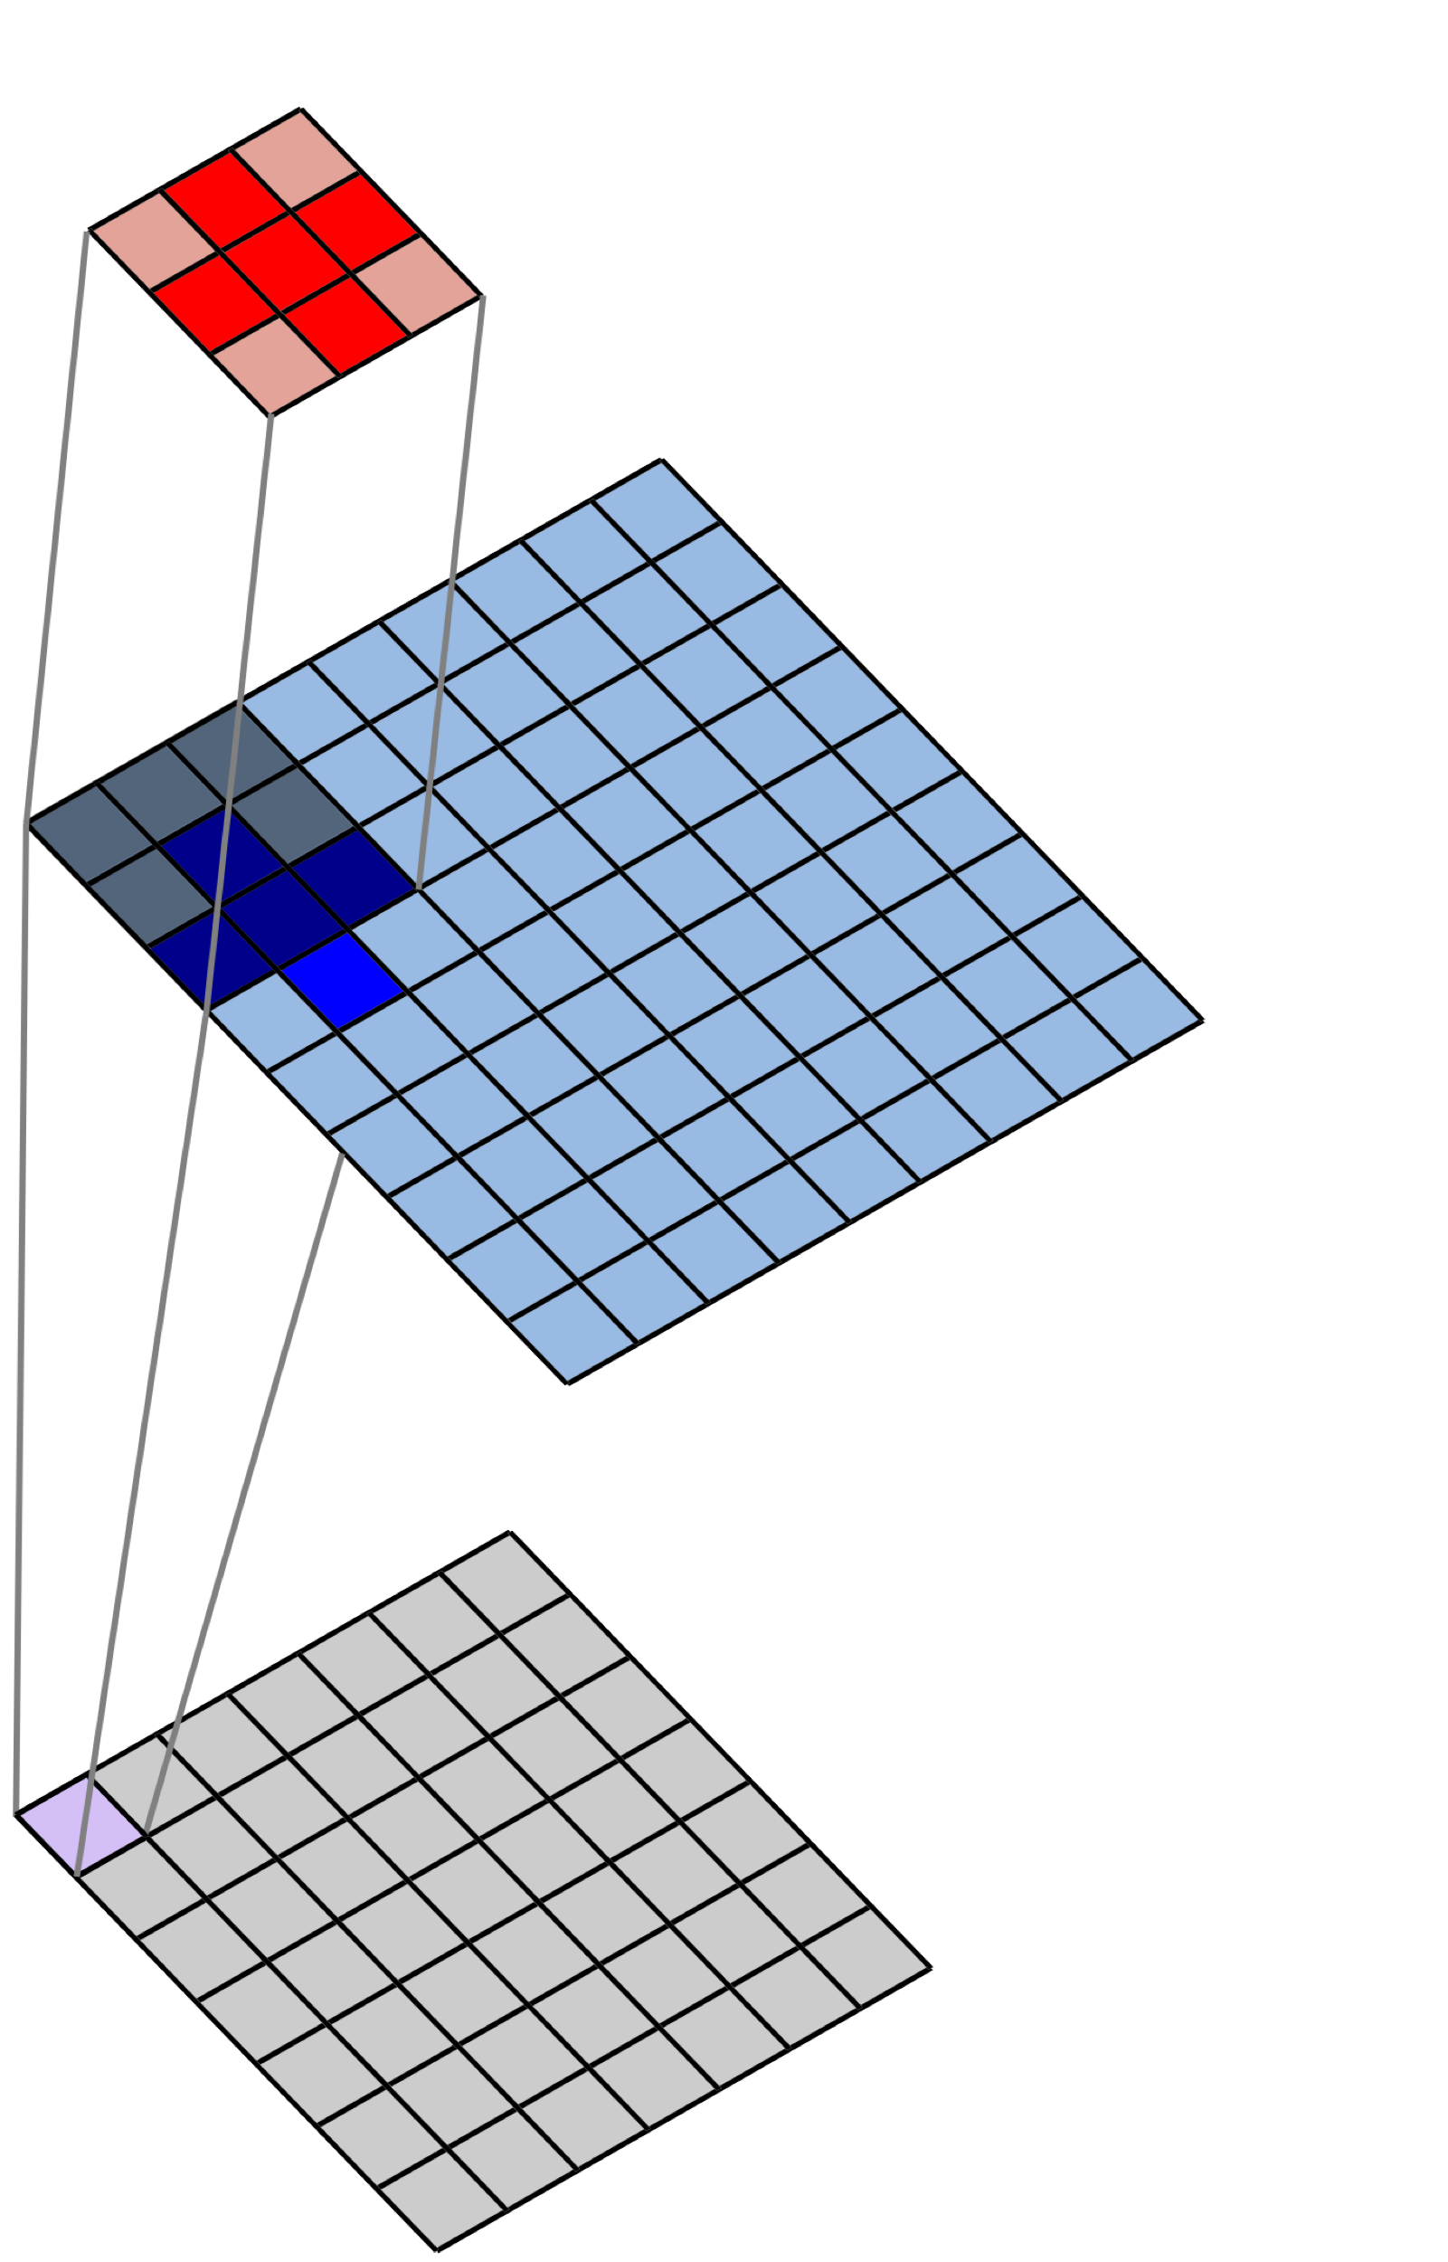

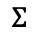
2D Spatial Convolution
Filter
$$×$$
Image
$$Σ$$
Convolved Image
(Feature Map)
Notes:
We’re going back to this, because we will point out that filters actually operate over volumes

Slide 30
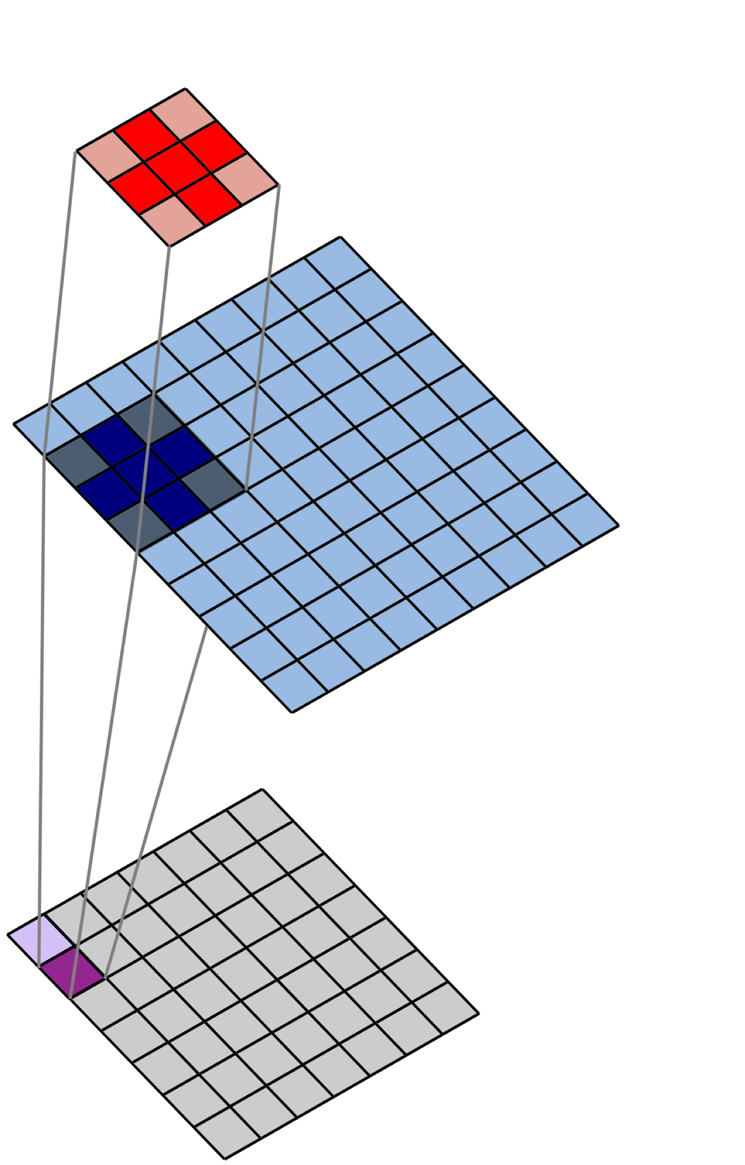
2D Spatial Convolution
Filter
$$×$$
Image
$$Σ$$
Convolved Image
(Feature Map)

Slide 31
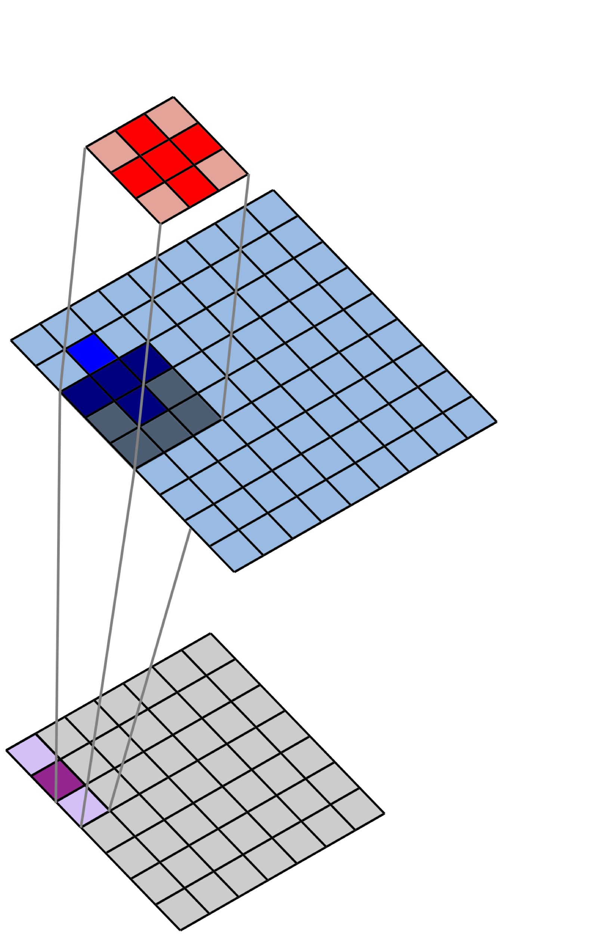
2D Spatial Convolution
Filter
$$×$$
Image
$$Σ$$
Convolved Image
(Feature Map)

Slide 32
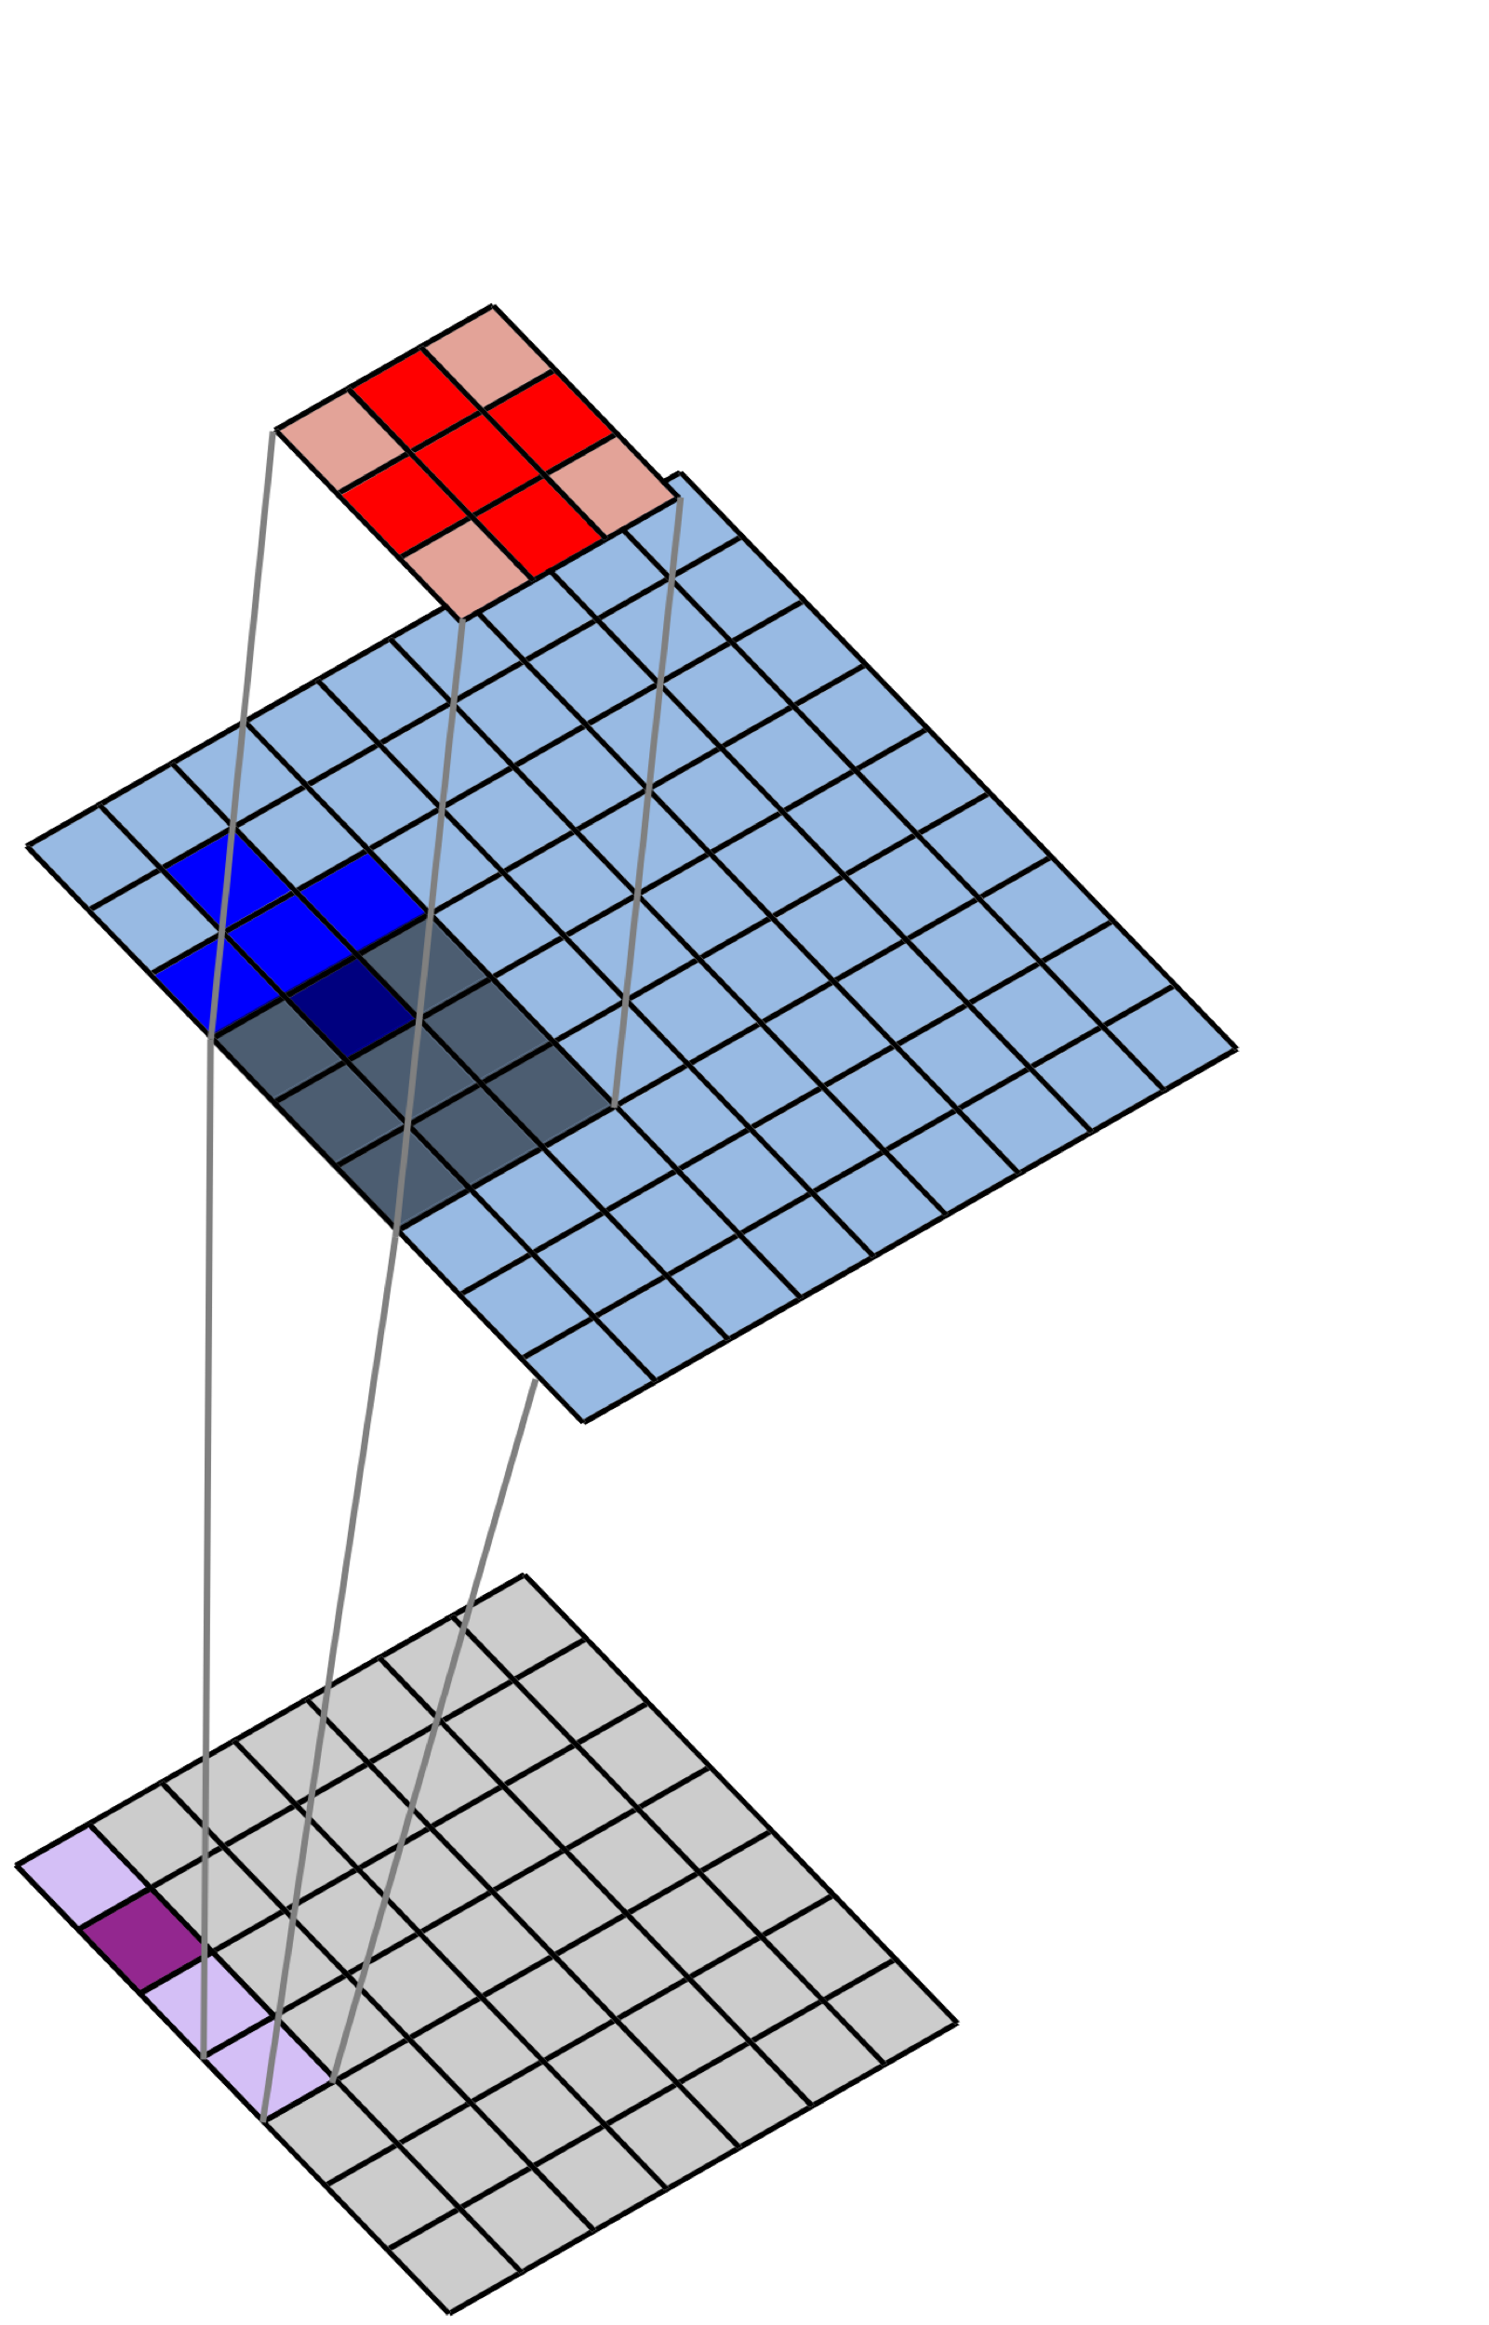
2D Spatial Convolution
Filter
$$×$$
Image
$$Σ$$
Convolved Image
(Feature Map)

Slide 33
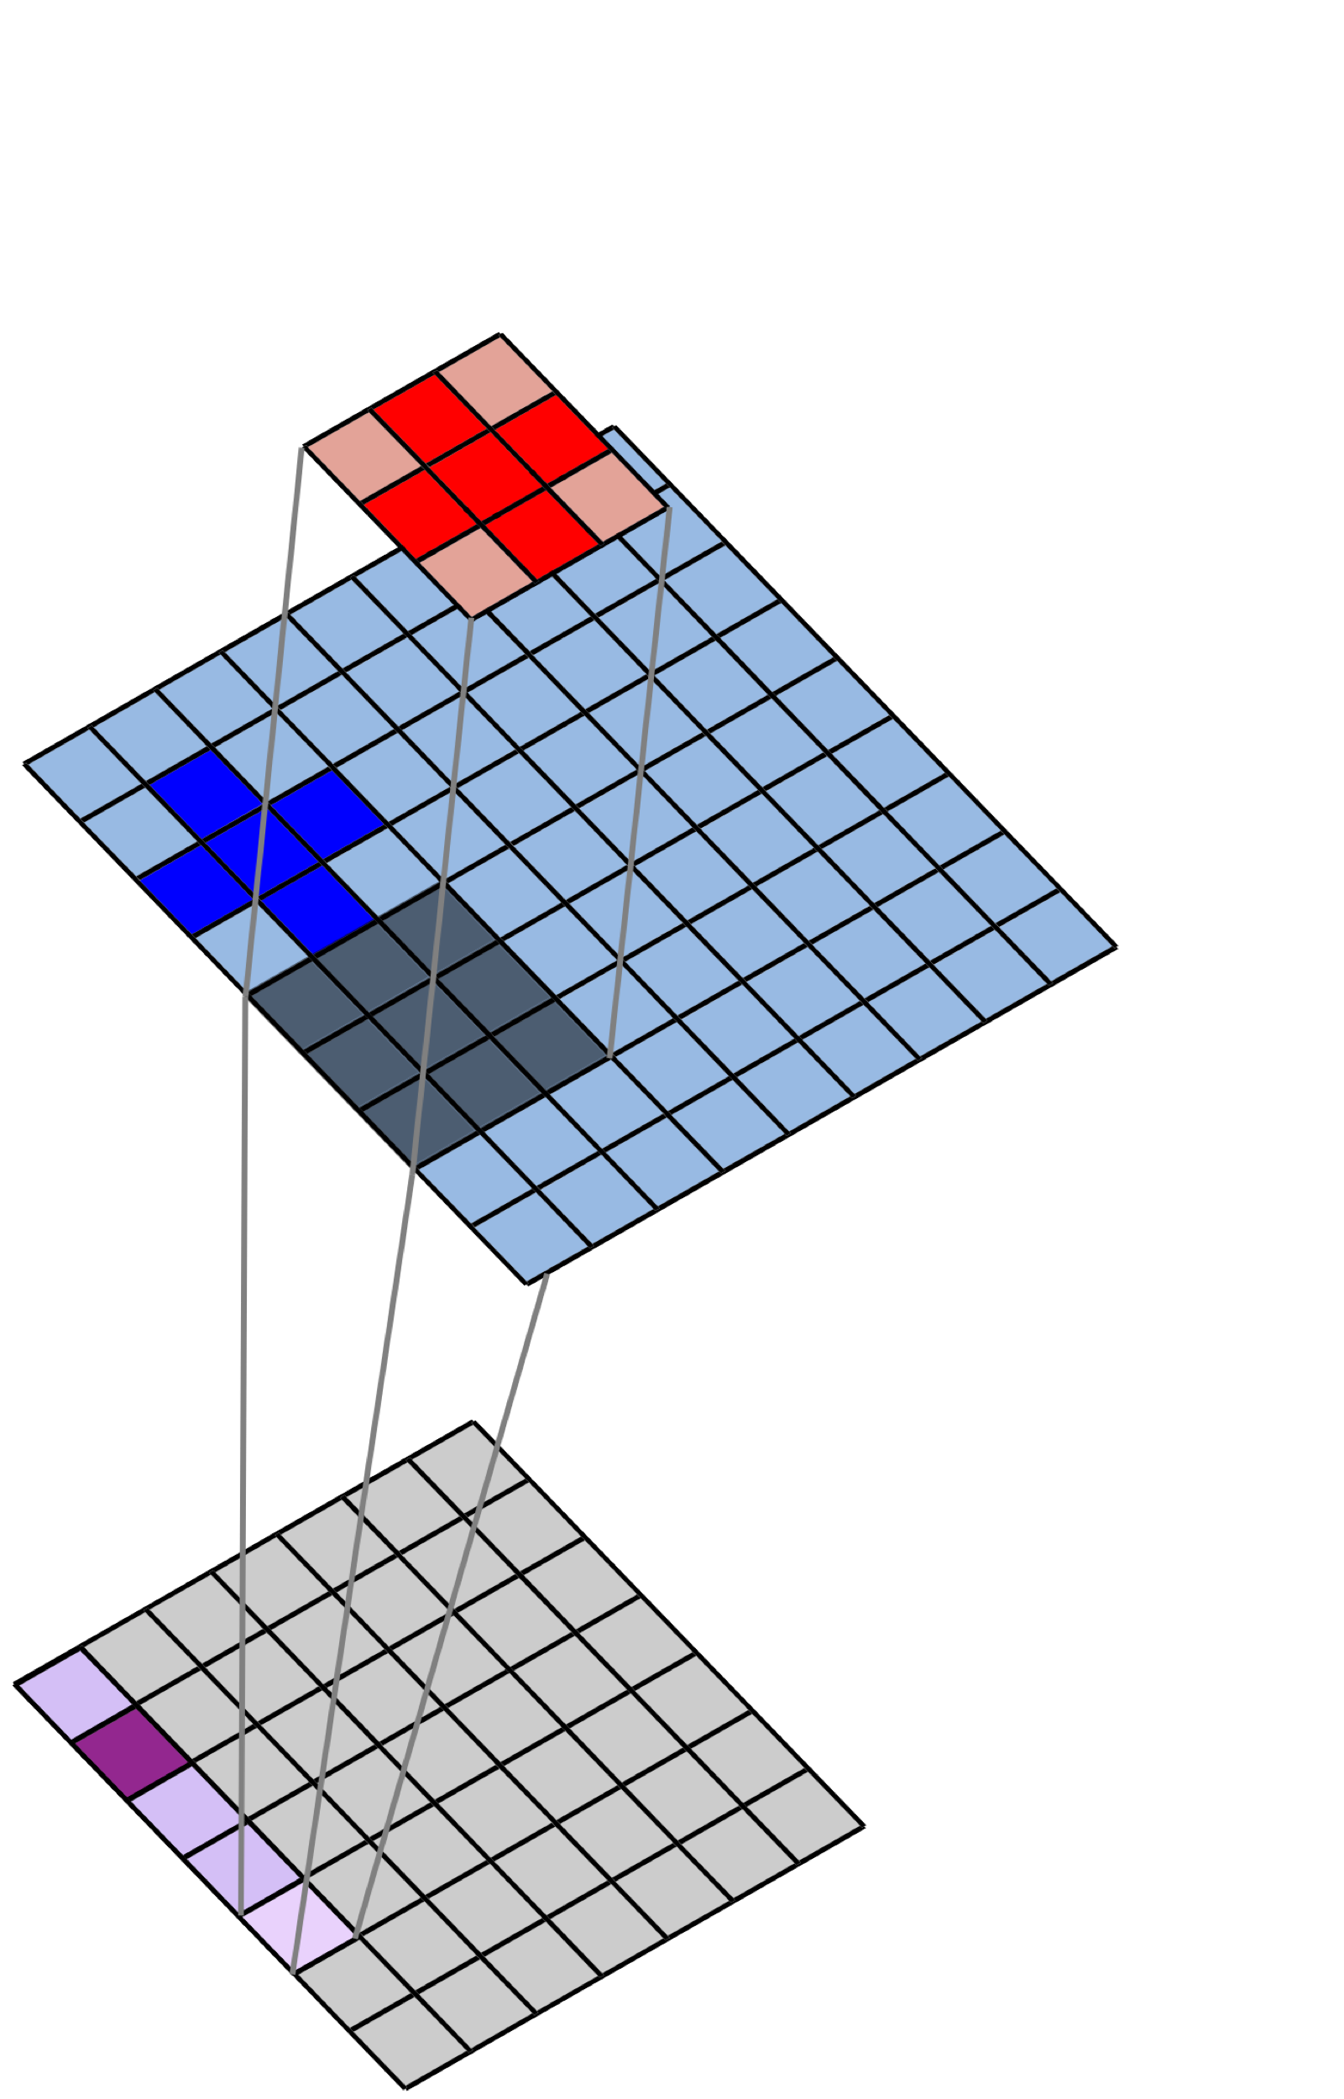
2D Spatial Convolution
Filter
$$×$$
Image
$$Σ$$
Convolved Image
(Feature Map)

Slide 34
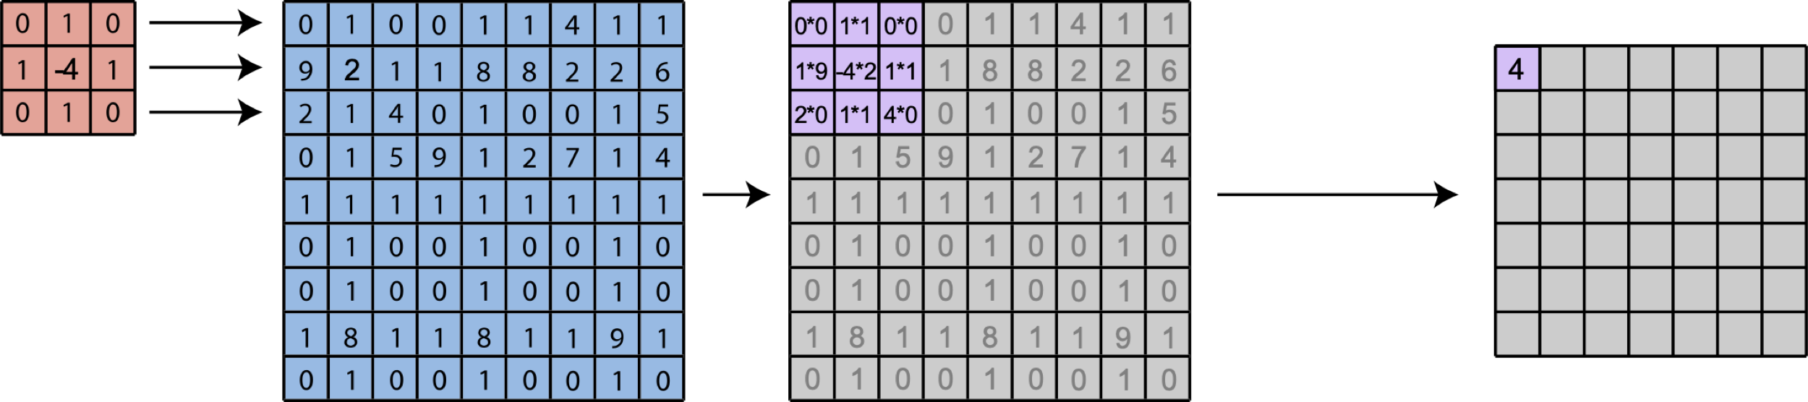
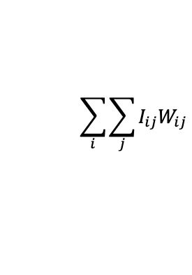
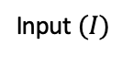
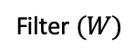
2D Spatial Convolution
Filter $(W)$
Input $(I)$
$$\sum_{i}{\sum_{j}{I_{ij}W_{ij}}}$$
Notes:
Apply this filter to a real image and show output

Slide 35
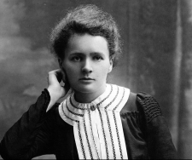
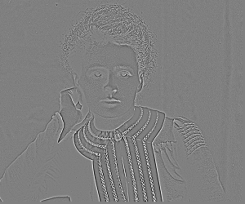
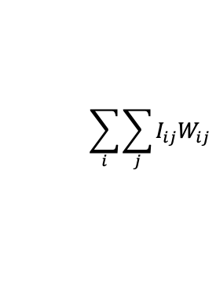
2D Spatial Convolution
Filter $(W)$
Input $(I)$
$$\sum_{i}{\sum_{j}{I_{ij}W_{ij}}}$$
Notes:
Apply this filter to a real image and show output. Maybe explain why this works to add time

Slide 36
Filters Operate Over Input Volumes
Feature “Maps”
Layer-2 Filters
Input Image
Filters

Slide 37
Filters Operate Over Input Volumes
Feature “Maps”
Layer-2 Filters
Input Image
Filters

Slide 38
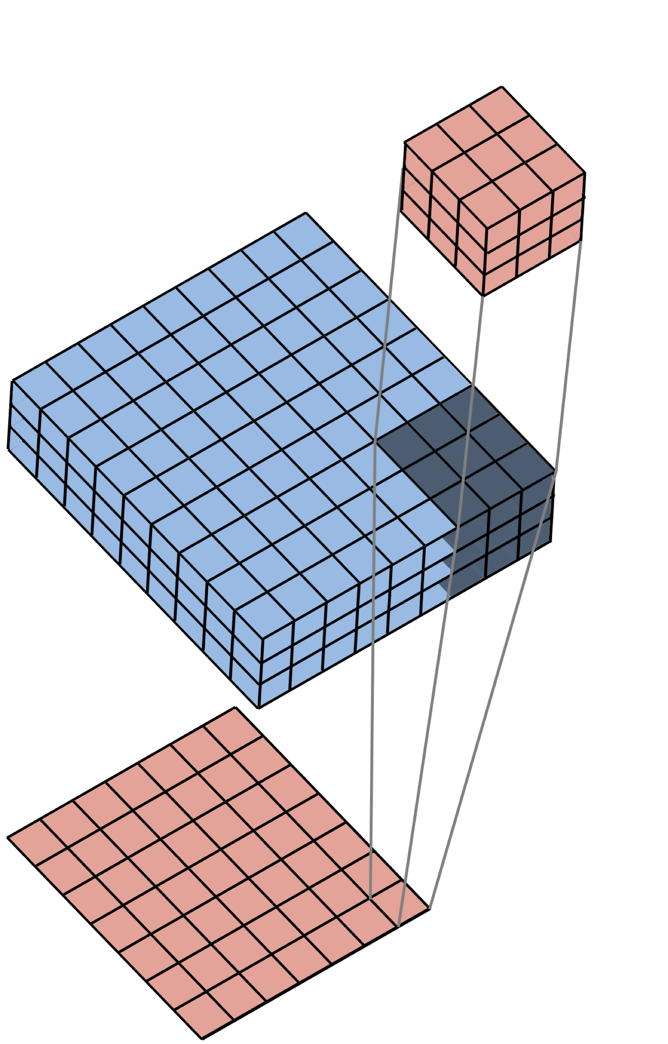
Filters Operate Over Input Volumes
Filter (3x3x3)
Image (9x9x3)
Feature Map (7x7x1)
Notes:
Mention that we’re going to show an example of this in the next slide

Slide 39
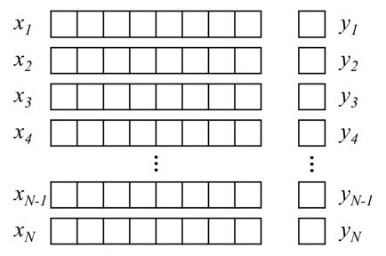
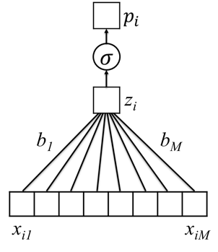
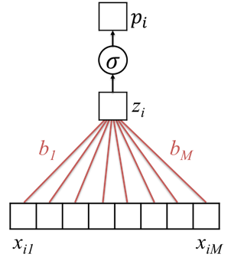
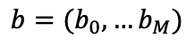
Given Labeled Training Images, How do we Learn the Parameters of the CNN?
Training Set
$$p_{i}=σ(b_{0}+b_{1}x_{i1}+b_{2}x_{i2}+…+b_{M}x_{iM})$$
$b=(b_{0},…b_{M})$
Untrained Logistic Regression
Model (or “Network”)
Trained Model (with learned parameters)

Slide 40
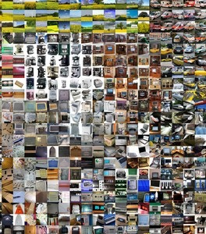
Given Labeled Training Images, How do we Learn the Parameters of the CNN?
CNN
Architecture
Trained
CNN

Slide 41
Architecture (specified) vs Parameters (learned)
Architecture:
Number of layers
Layer types (e.g. convolutional, pooling, fully connected)
Number of filters in each layer
Shape and size of filters
Use 3x3 filters
In layer 1
Parameters:
Individual Elements of each filter
Parameters of other layers
Learn values of
Each layer 1 filter
-1 | 1 | -1
1 | -1 | 1
-1 | 1 | -1

Slide 42
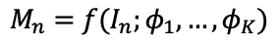
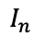
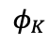
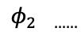
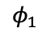
Feature “Maps”
$$M_{n}=f(I_{n};φ_{1},…,φ_{K})$$
$$φ_{1}$$
$$φ_{2 ……}$$
$$φ_{K}$$
Input Image
Layer-1 Filters
$$I_{n}$$
Notes:
Simplify this – the point is just that one filter gives us one feature map
Remember, we’re working our way toward the loss.
Emphasize here that these are individual filters ultimately contributing to a loss

Slide 43
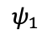
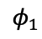
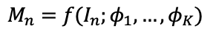
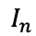
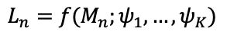
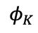
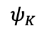
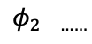
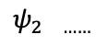
Layer 2 Feature “Maps”
$$L_{n}=f(M_{n};ψ_{1},…,ψ_{K})$$
$$ψ_{1}$$
$$ψ_{2 ……}$$
$$ψ_{K}$$
Layer-2 Filters
Layer 1 Feature “Maps”
$$M_{n}=f(I_{n};φ_{1},…,φ_{K})$$
$$φ_{1}$$
$$φ_{2 ……}$$
$$φ_{K}$$
Input Image
Layer-1 Filters
$$I_{n}$$

Slide 44
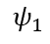
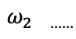
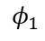
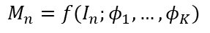
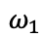
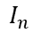
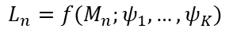
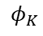
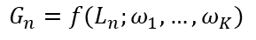
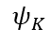
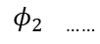


Layer 3 Feature “Maps”
$$G_{n}=f(L_{n};ω_{1},…,ω_{K})$$
$$ω_{1}$$
$$ω_{2 ……}$$
$$ω_{K}$$
Layer-3 Filters
Layer 2 Feature “Maps”
$$L_{n}=f(M_{n};ψ_{1},…,ψ_{K})$$
$$ψ_{1}$$
$ψ_{2 ……}$
$$ψ_{K}$$
Layer-2 Filters
Layer 1 Feature “Maps”
$$M_{n}=f(I_{n};φ_{1},…,φ_{K})$$
$$φ_{1}$$
$${ φ}_{2 ……}$$
$$φ_{K}$$
Input Image
Layer-1 Filters
$$I_{n}$$

Slide 45














Layer 3 Feature “Maps”
$$G_{n}=f(L_{n};ω_{1},…,ω_{K})$$
$$ℓ(G_{n};W)$$
$$ω_{1}$$
$$ω_{2 ……}$$
$$ω_{K}$$
Layer-3 Filters
Layer 2 Feature “Maps”
$$L_{n}=f(M_{n};ψ_{1},…,ψ_{K})$$
$$ψ_{1}$$
$ψ_{2 ……}$
$$ψ_{K}$$
Layer-2 Filters
Layer 1 Feature “Maps”
$$M_{n}=f(I_{n};φ_{1},…,φ_{K})$$
$$φ_{1}$$
$${ φ}_{2 ……}$$
$$φ_{K}$$
Input Image
Layer-1 Filters
$$I_{n}$$

Slide 46















$$G_{n}=f(L_{n};ω_{1},…,ω_{K})$$
Layer 3
Feature “Maps”
$$ℓ\left(G_{n};W\right)=ℓ_{n}$$
$$ω_{1}$$
$${ ω}_{2 ……}$$
$$ω_{K}$$
Assume we have labeled images ${\left\{I_{n},y_{n}\right\}}_{n=1,N}$
$I_{n}$ is image n, $y_{n}∈\{+1,−1\}$ is associated label
Average loss, which depends on model parameters:
Find specific parameters that minimize the average loss
Layer-3 Filters
Layer 2
Feature “Maps”
$$L_{n}=f(M_{n};ψ_{1},…,ψ_{K})$$
$$ψ_{1}$$
$ψ_{2 ……}$
$$ψ_{K}$$
$$1/N\sum_{n=1}^{N}{loss(y_{n},ℓ_{n})}$$
Layer-2 Filters
Layer 1
Feature “Maps”
$$M_{n}=f(I_{n};φ_{1},…,φ_{K})$$
$$φ_{1}$$
$${ φ}_{2 ……}$$
$$φ_{K}$$
Input Image
Layer-1 Filters
$$I_{n}$$

Slide 47
Summary
Convolutional neural networks learn to recognize high-level structure in images by building hierarchical representations of features
Features are extracted via spatial convolutions with filters
Filters are learned via iterative minimization of a loss function
Convolutional neural networks have shown capabilities beyond human performance for image analysis

